Slide 1
Power and Simplicity of Geospatial Analysis using DuckDB

Slide 2
Workshop Goals
For Beginners:
Exposure to a spatial analysis project in SQL
For Experienced Users:
Enhance existing Python workflows with DuckDB.
Experience rapid big data processing locally.
Leverage DuckDB's spatial functions and extensions.

Slide 3
About Me
Claire Palmer, GISP
Geospatial professional 10+ years
GIS Programmer, Milliman, 3.5 years
50% Postgres + PostGIS
40% Python + DuckDB
10% Python + ArcPy
Flood, Fire, Telematics

Slide 4
Agenda
DuckDB Overview
Analysis scripts:
Project objective
script 00 – basic Duckdb connection, I/O
script 01– population in FHSZ areas for Sonoma Co

Slide 5

DuckDB Overview
Portable open-source database system
Efficiently query GB of data from different sources
Friendly SQL dialect
New capabilities with extensions
Spatial support
duckdb.org

Slide 6
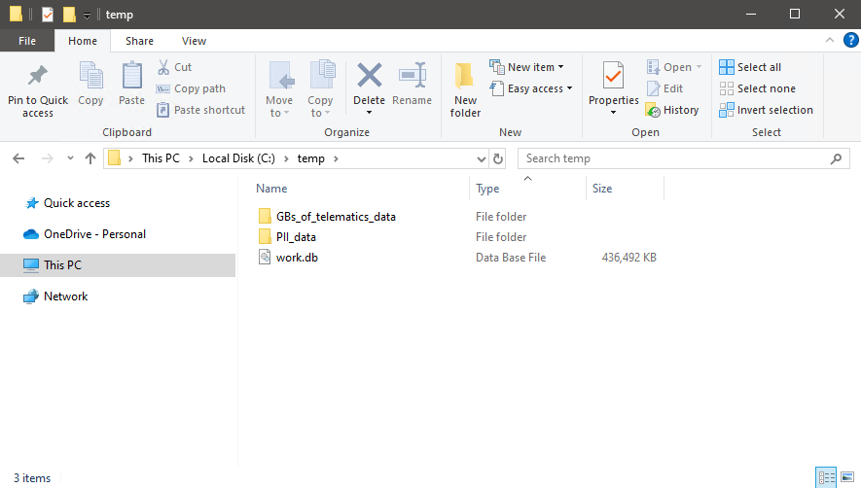
DuckDB Overview
Portable open-source database system
no config, no docker, no server
1 database = 1 file
easy to set up
fast analysis using sql
only one connection at a time

Slide 7
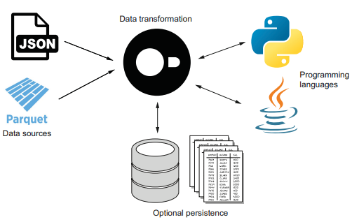
DuckDB Overview
Efficiently query GB of data from different sources
“.. if it quacks like a duck, then it probably is a duck. If it looks like a table, you can query it.”
DuckDB in Action pdf
https://motherduck.com/duckdb-book-form/

Slide 8
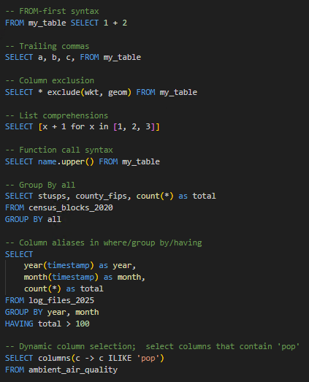
DuckDB Overview
Friendly SQL
based on PostgreSQL dialect
python inspired for programmatic ease
syntax shortcuts

Slide 9
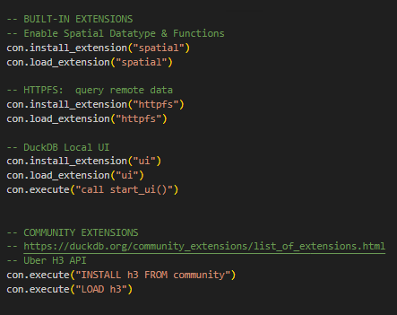
DuckDB Overview
New capabilities with extensions
Spatial Data/Functions
Query AWS/Azure data
Connect to a Postgres database
… and many more
new functionality added often

Slide 10
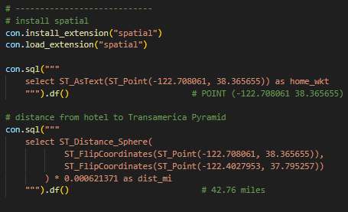
DuckDB Overview
Spatial extension
Version 0.9 (04/2023) geometry datatype
Version 1.1 (09/2024) support for geoparquet and rtree indexes
ST_ functions are modeled after PostGIS
simple geometries only
no geography or raster support …yet

Slide 11
Counter-Point
Why would I use DuckDB if my pipelines with python + pandas/Geopandas work just fine?
DuckDB can load & analyze big datasets faster.
DuckDB Spatial SQL can potentially execute many operations in one spatial query, thus eliminating several calls to the data.

Slide 12
Counter-Point
Our tooling is exclusively done in the arcpy ecosystem. How would DuckDB benefit my organization?
DuckDB with the httpfs/azure extensions can import Overture Maps data in the parquet format.
DuckDB can extend the arcpy environment by
making it easier to connect to & analyze non-ESRI data sources
bringing in additional functionality like the H3 library to use directly in SQL queries

Slide 13
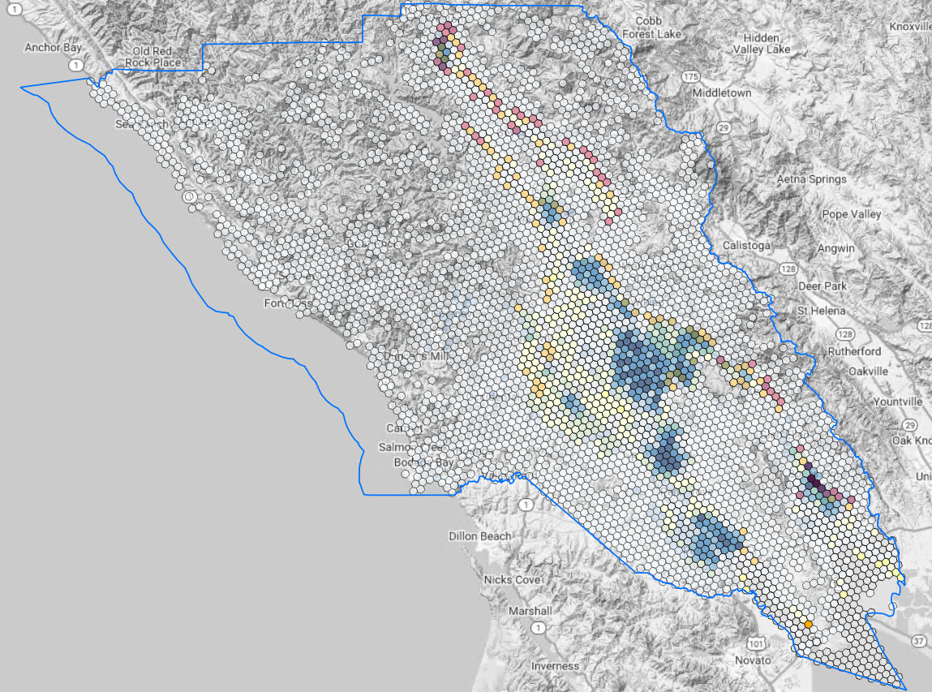
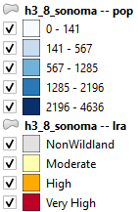
Analysis Project
Objective
Get total population for Sonoma County Fire Hazard Severity Zones (LRAs)
New Local Responsibility Areas were released for Sonoma County 2/24/2025 https://osfm.fire.ca.gov/what-we-do/community-wildfire-preparedness-and-mitigation/fire-hazard-severity-zones

Slide 14
Analysis Project
Key skills
Import various file types (arcgis feature service layer, shp, feature class, csv)
Use the H3 extension to create grid & aggregate population
Use ST_ functions to re-project and analyze data
Do it all in the arcpy environment.

Slide 15
Analysis Project
Download Project Data:
https://github.com/cmpalmer20/CalGIS

Slide 16
Resources
https://what-the-h3index.vercel.app/ # H3 index viewer
https://wktmap.com/ # WKT viewer
https://duckdb.org/docs/stable/extensions/spatial/functions.html # DuckDB spatial functions
https://postgis.net/docs/reference.html # PostGIS spatial functions
https://duckdb.org/release_calendar # DuckDB release calendar
https://duckdb.org/news/ # DuckDB blog
https://duckdb.org/community_extensions/list_of_extensions.html # DuckDB community extensions
https://h3geo.org/docs/api/indexing/ # H3 API
https://docs.overturemaps.org/release/latest/ # Overture Maps latest release notes
https://data.humdata.org/dataset/kontur-population-united-states-of-america # Kontur US population hexagons
https://motherduck.com/duckdb-book-form/ # DuckDB In Action book
https://locatepress.com/book/spatial-sql # Spatial SQL by Matt Forrest. Classic PostGIS query patterns. Worth it!

Slide 17
claire.palmer@milliman.com
Milliman

